Slide 1
Generator Locations
Blue and Green markers indicate generator buses
Yellow and Pink markers indicate generators
Using two different colors for each type just helped me during the assignment process; they have no other meanings

Slide 2
NPCC

Slide 3
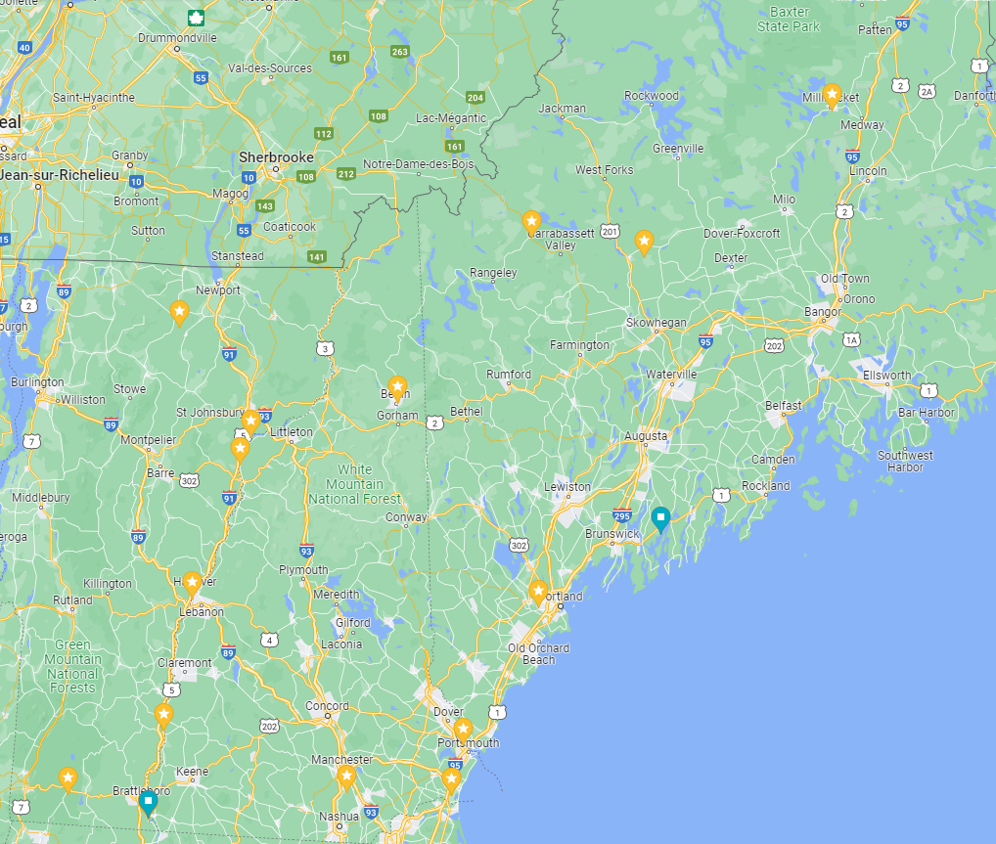
Vermont, New Hampshire, and Maine Generators

Slide 4
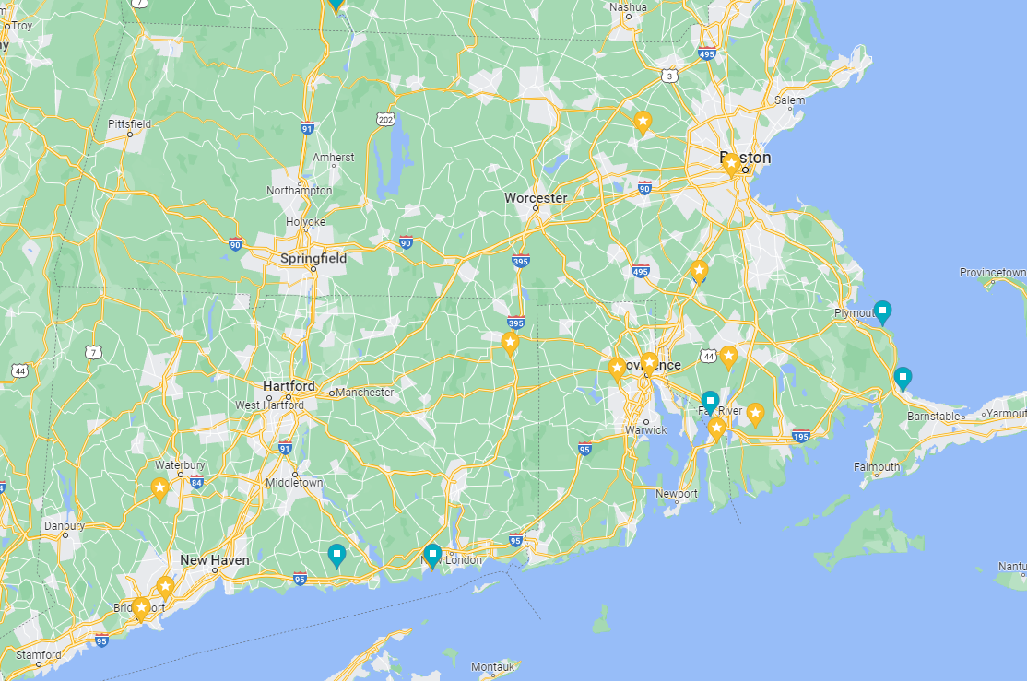
Massachusetts, Connecticut, and Rhode Island Generators

Slide 5
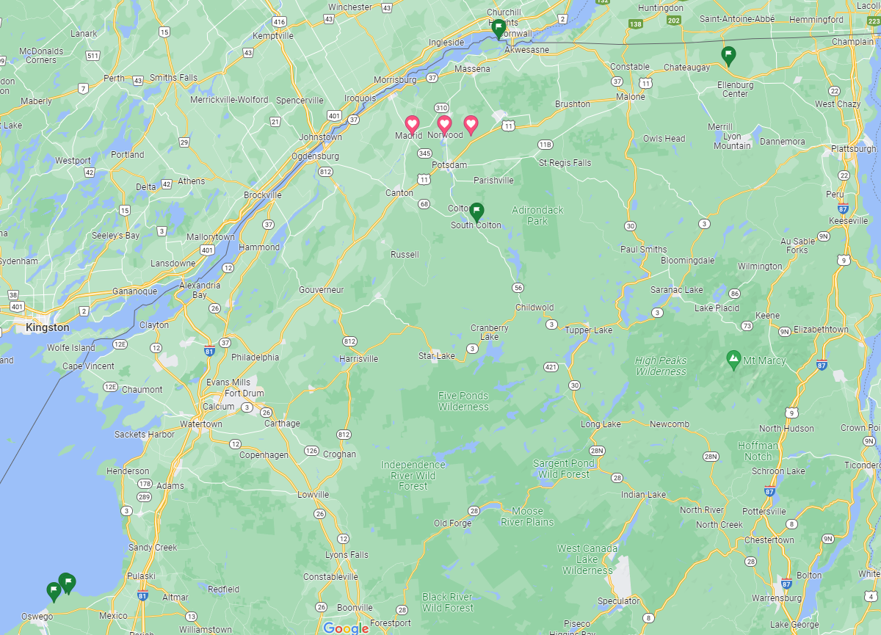
New York Generators

Slide 6
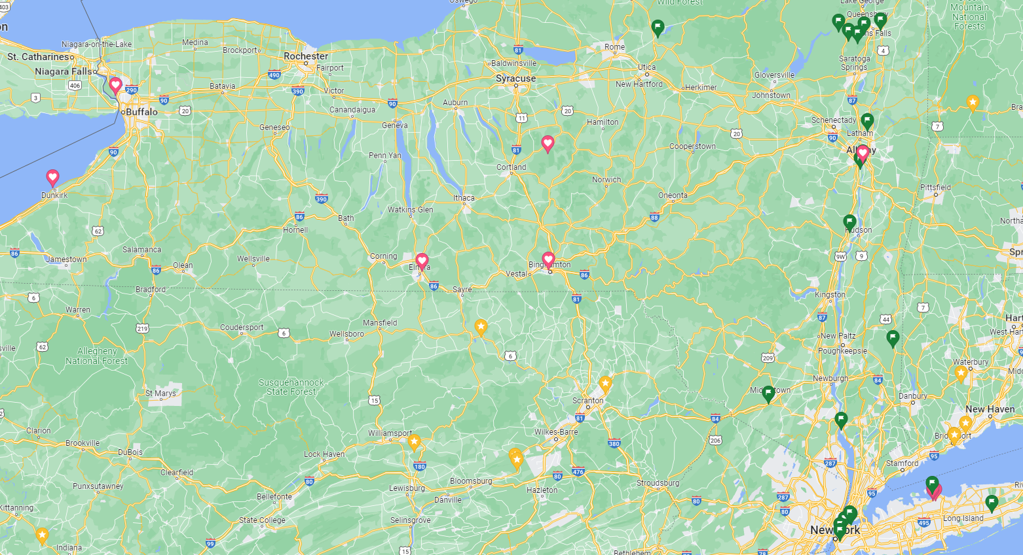
New York Generators (cont.)

Slide 7
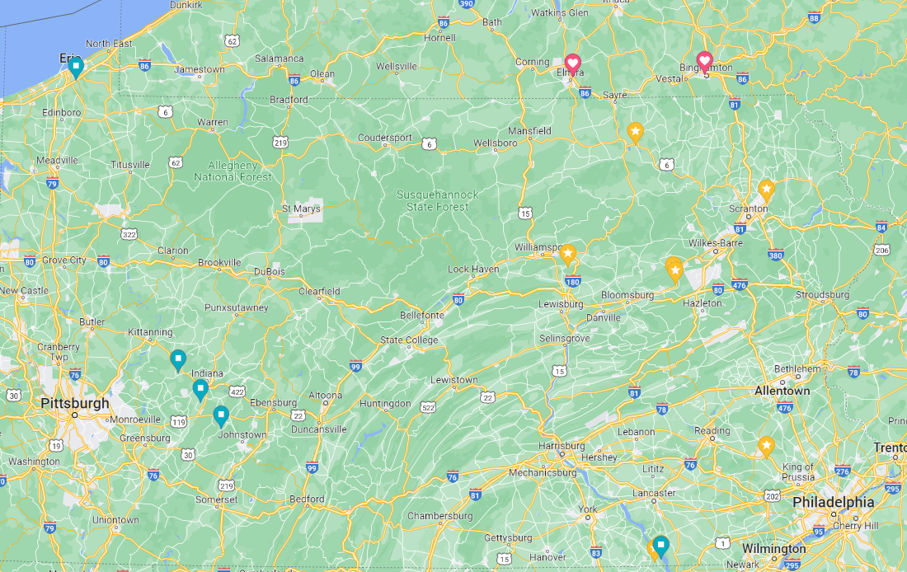
Pennsylvania Generators

Slide 8
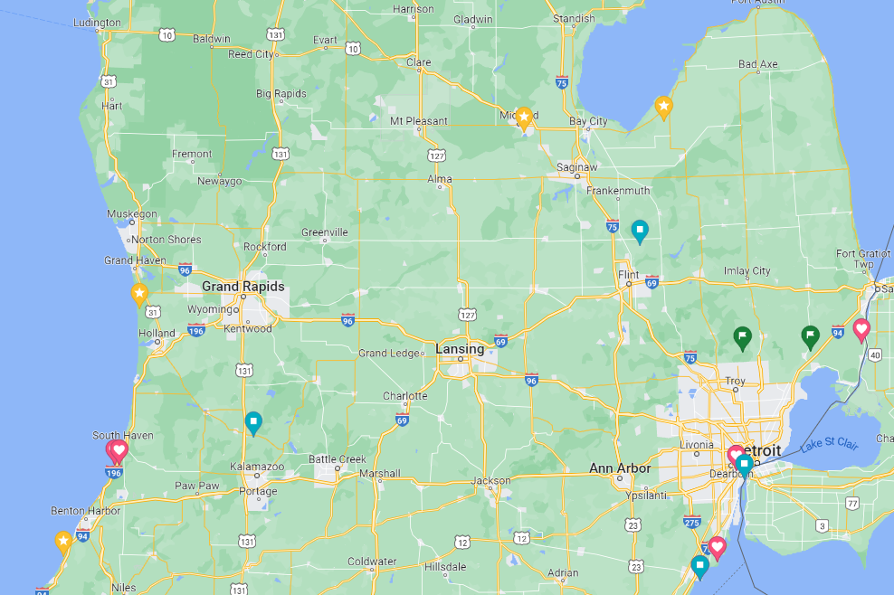
Michigan Generators

Slide 9
WECC

Slide 10
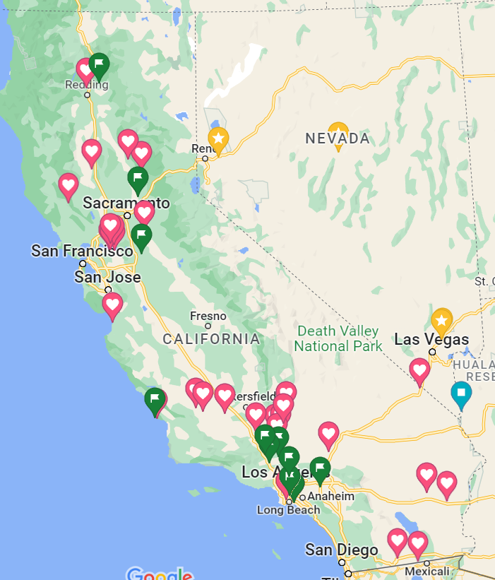
California and Nevada Generators

Slide 11
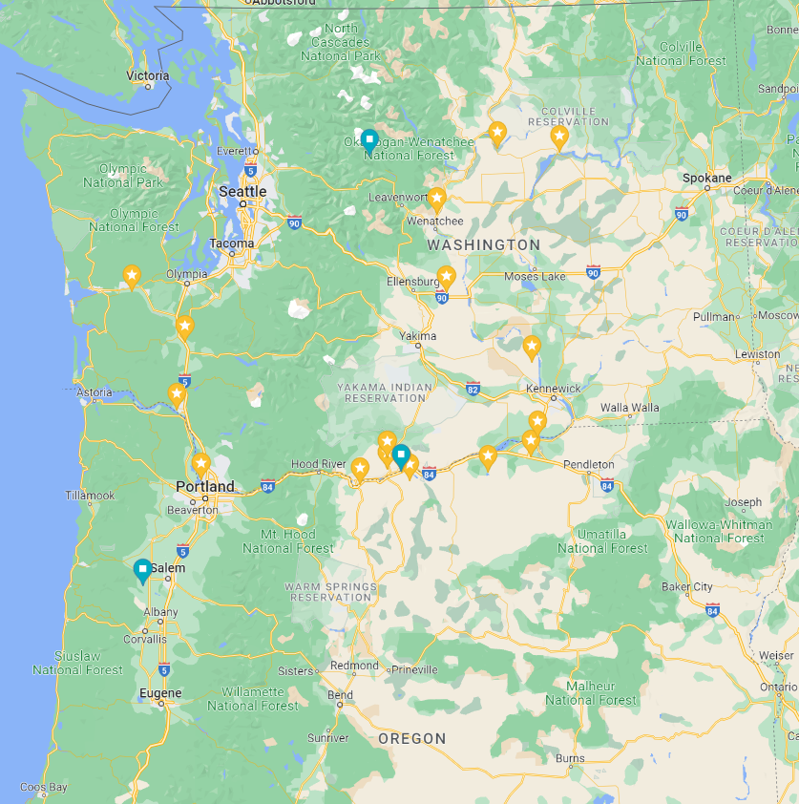
Washington and Oregon Generators

Slide 12
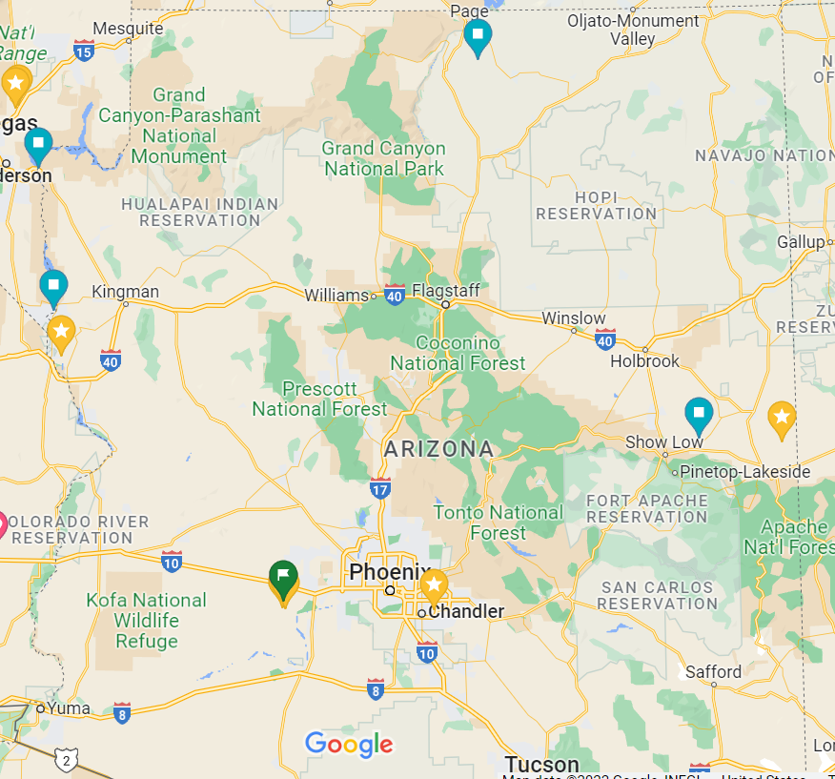
Arizona Generators

Slide 13
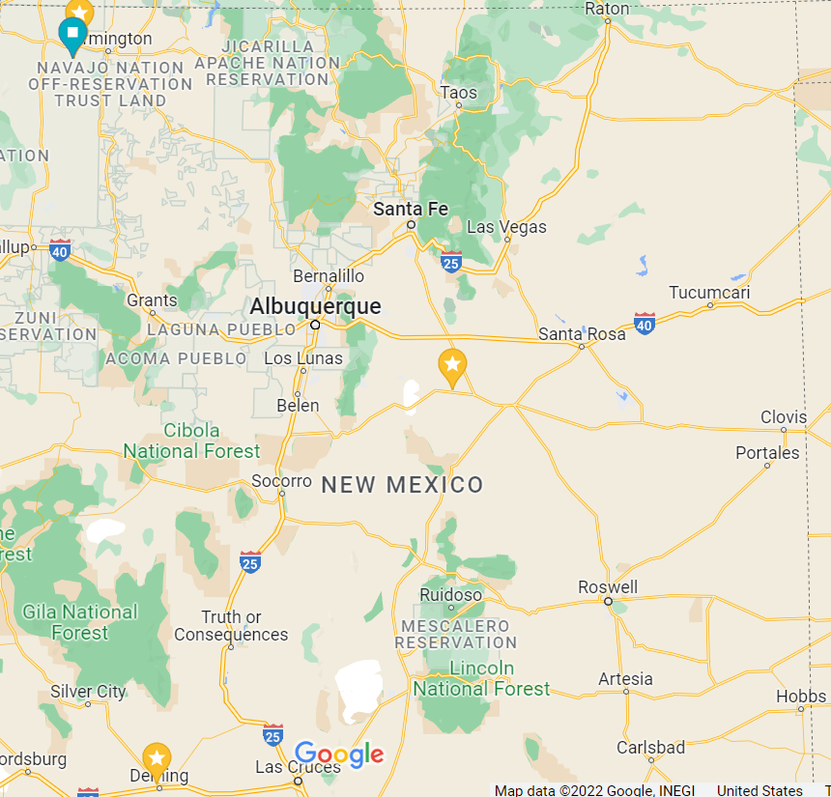
New Mexico Generators

Slide 14
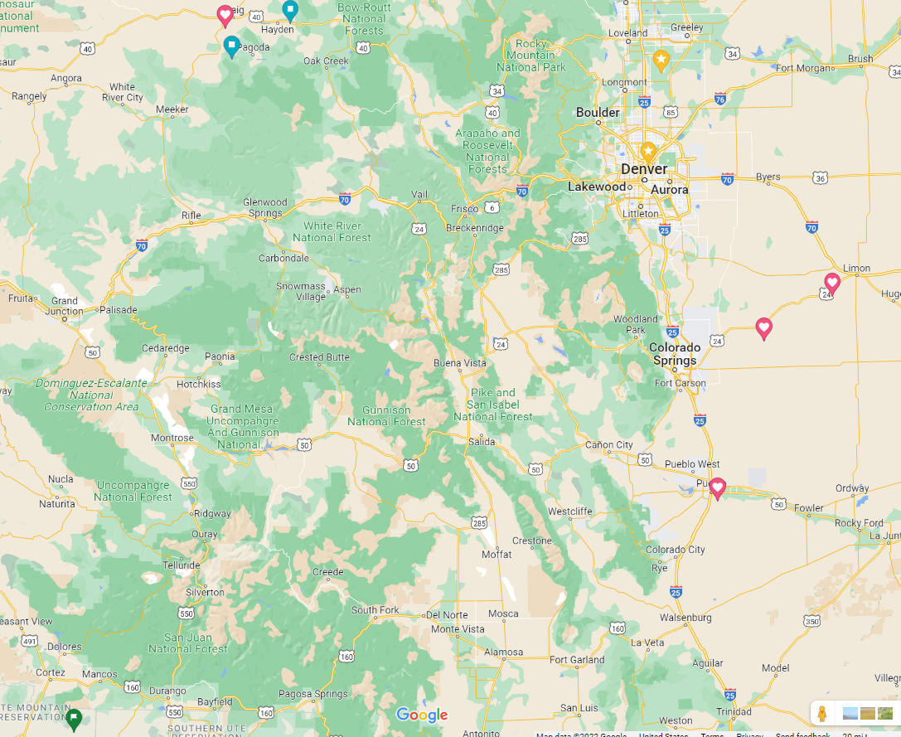
Colorado Generators

Slide 15
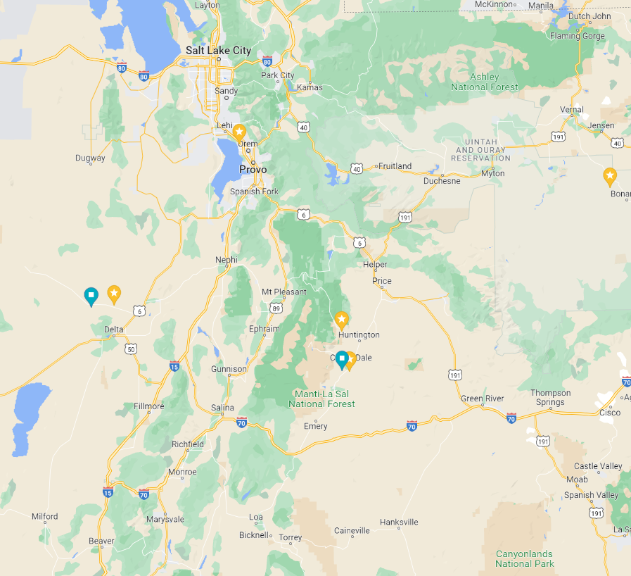
Utah Generators

Slide 16
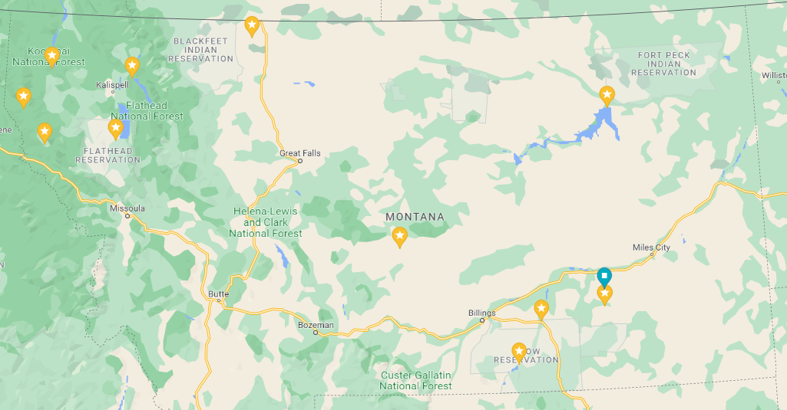
Montana Generators

Slide 17
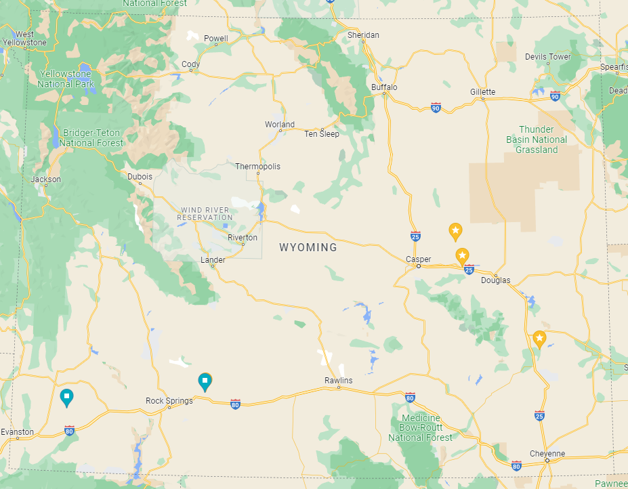
Wyoming Generators

